Slide 1
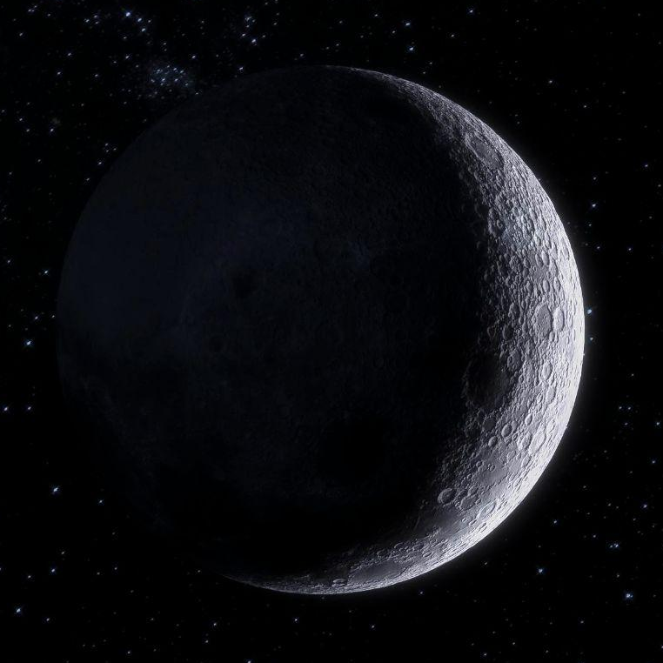

Improvement of an SSA simulator and feasibility analysis of space missions
Inés Arauzo Andrés Ángel Porras Hermoso

Slide 2
TABLE OF CONTENTS
01
OVERVIEW
02
CODE REFACTORIZATION
03
PHOTOMETRY
04
ANALYSIS
Introduction to the problem
Code structure and improvements
Light reflexion measures
Results of the project
05
CONCLUSIONS
Summary and future work

Slide 3
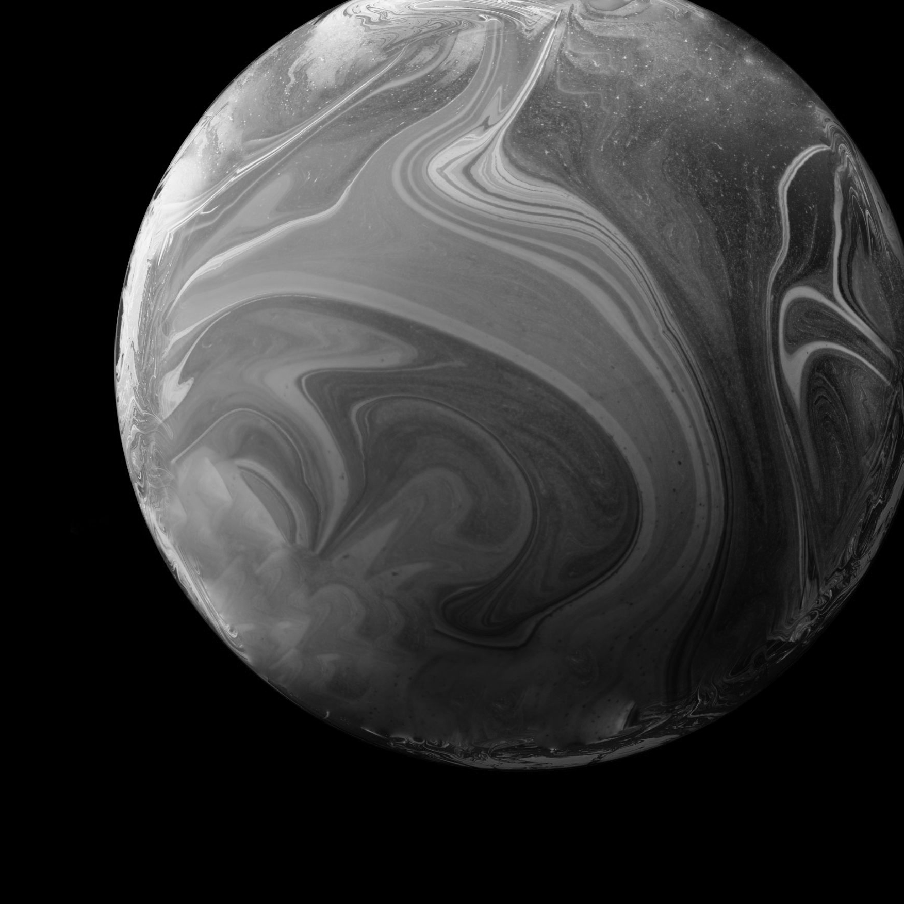
01
OVERVIEW

Slide 4
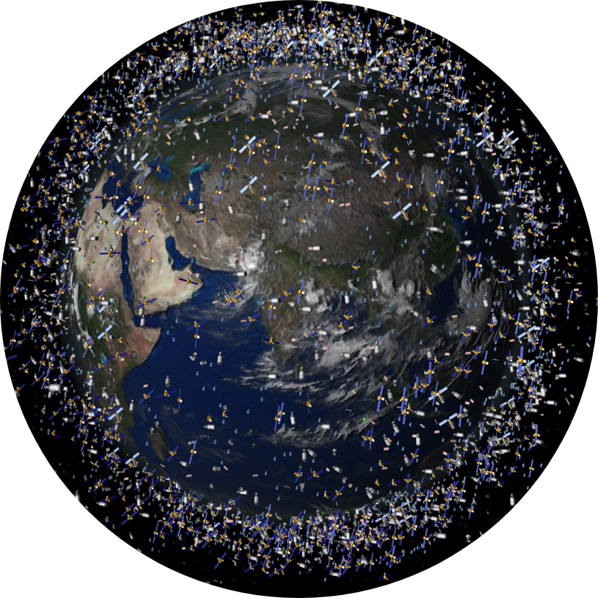
INTRODUCTION
Continuous growth of space debris has become a Hazard.
Role of Space Situational Awareness
Space based SSA vs Earth based SSA.
Role of SSA simulators.
1/16

Slide 5
MAIN OBJECTIVES
CODE
PHOTOMETRY
RANGES OF OBSERVATION
ESTIMATOR PRECISSION
Get measurements of light emitted by RSO’s.
Refactor the code following a modular philosophy.
Determine visibility windows and ranges of observation
Define UKF precission
2/16

Slide 6
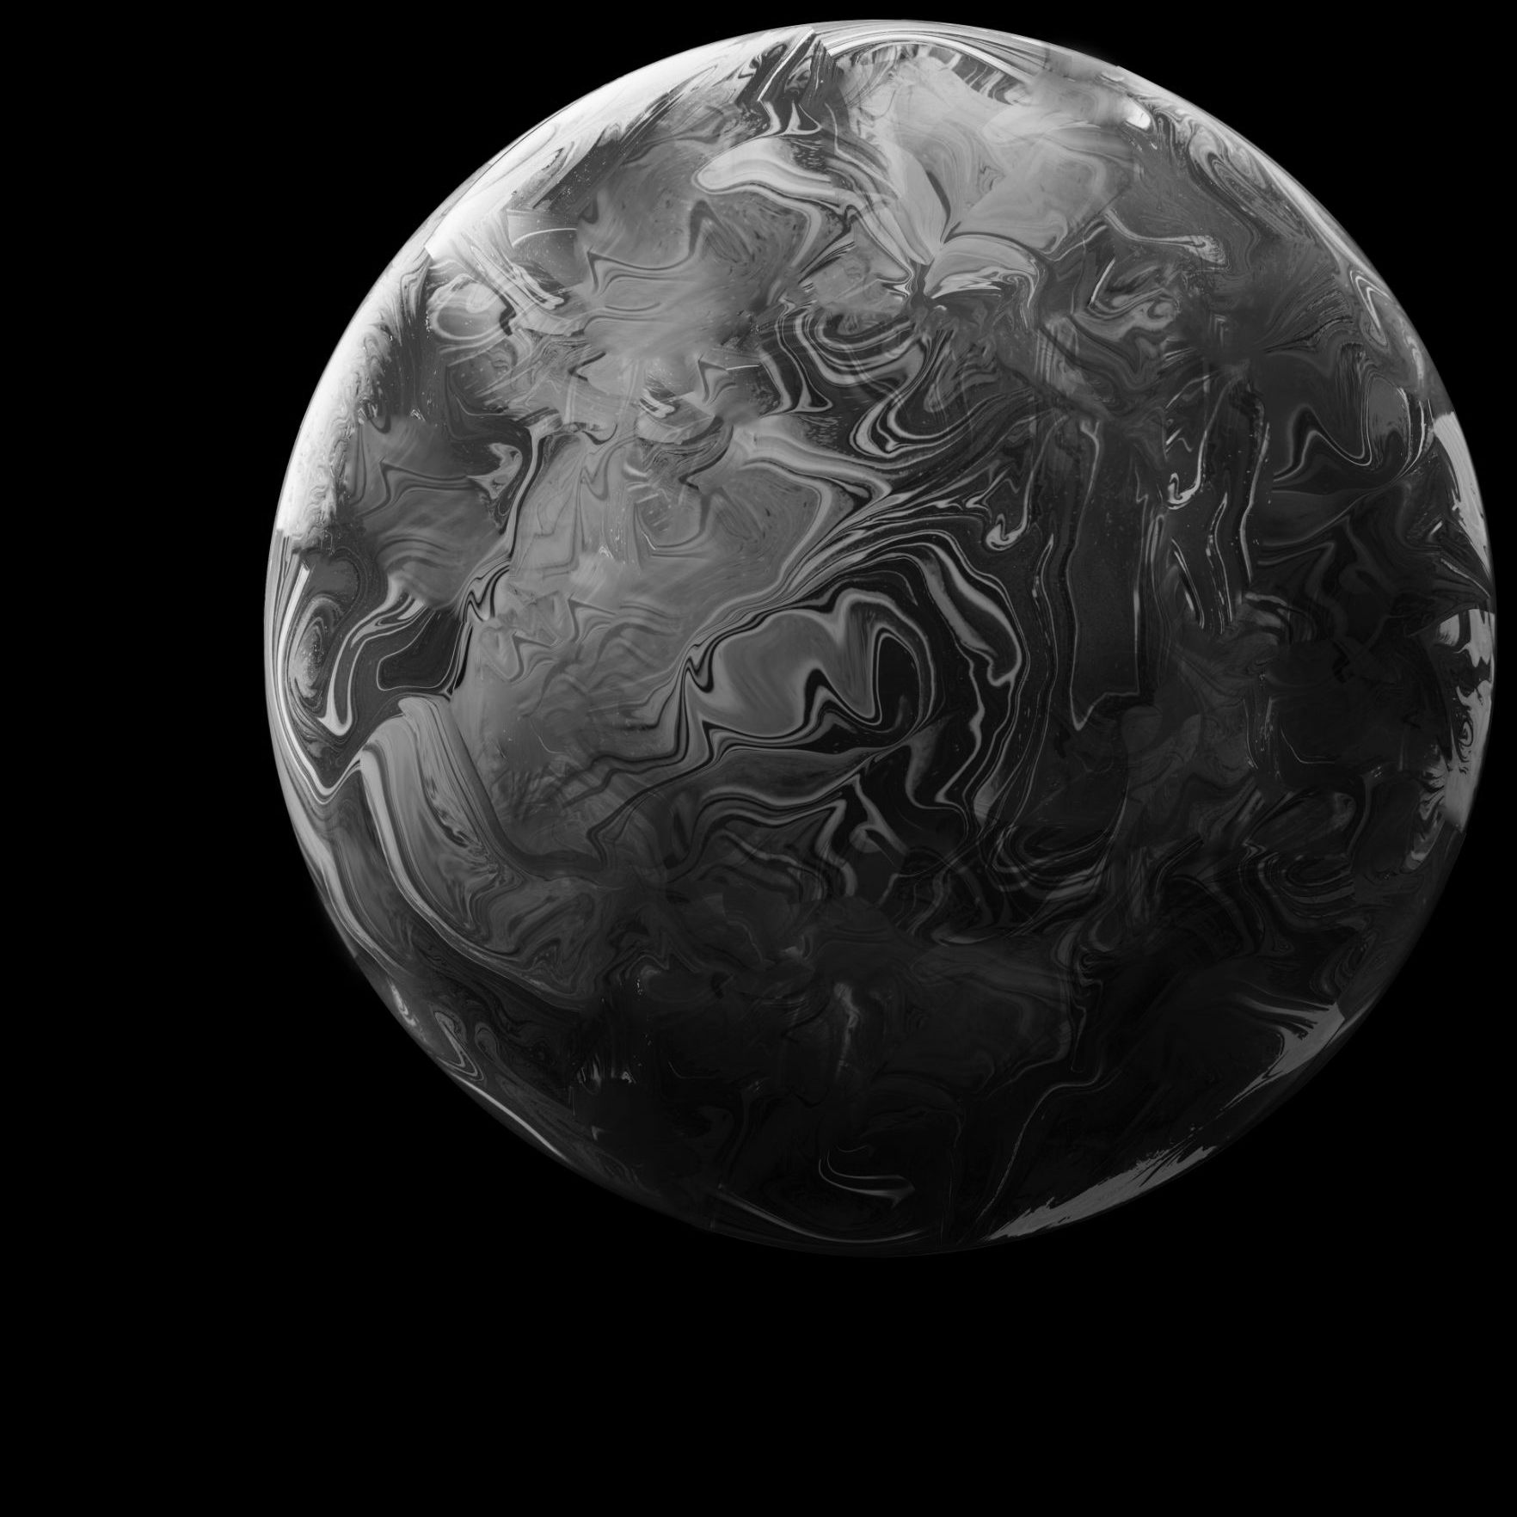
02
CODE REFACTORIZATION

Slide 7
INITIAL CODE
CODE STRUCTURE
MAIN PROBLEMS
Main Program
Simulation
Difficult to comprehend
Spaghetti-code philosophy
Impossible to introduce new features
Repeated parameters
Simulation parameters
Simulation errors
Estimator structure and parameters
Other essential components
3/16

Slide 8
NEW CODE
STRUCTURE
Simulator Configuration
Main Program
Estimation
Physics
Simulation
Photometry
Utilities
UKF Predictor
Orbit Parameters
Satellite
Apparent Magnitude
Rotation Matrix
UKF Corrector
Data Simulation
Julian Date
Random quaternions
Back Propagator
Sun Ephemerids
Sim Measures
4/16

Slide 9
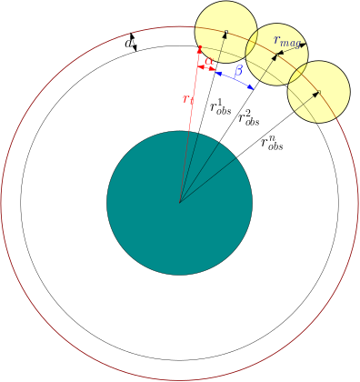
IMPROVEMENTS
New structure
Creation of configuration file Sim_Config.m
First approach to an observers constellation (BTH and ATH)
Implementation of a photometry module
UKF Analysis
5/16

Slide 10
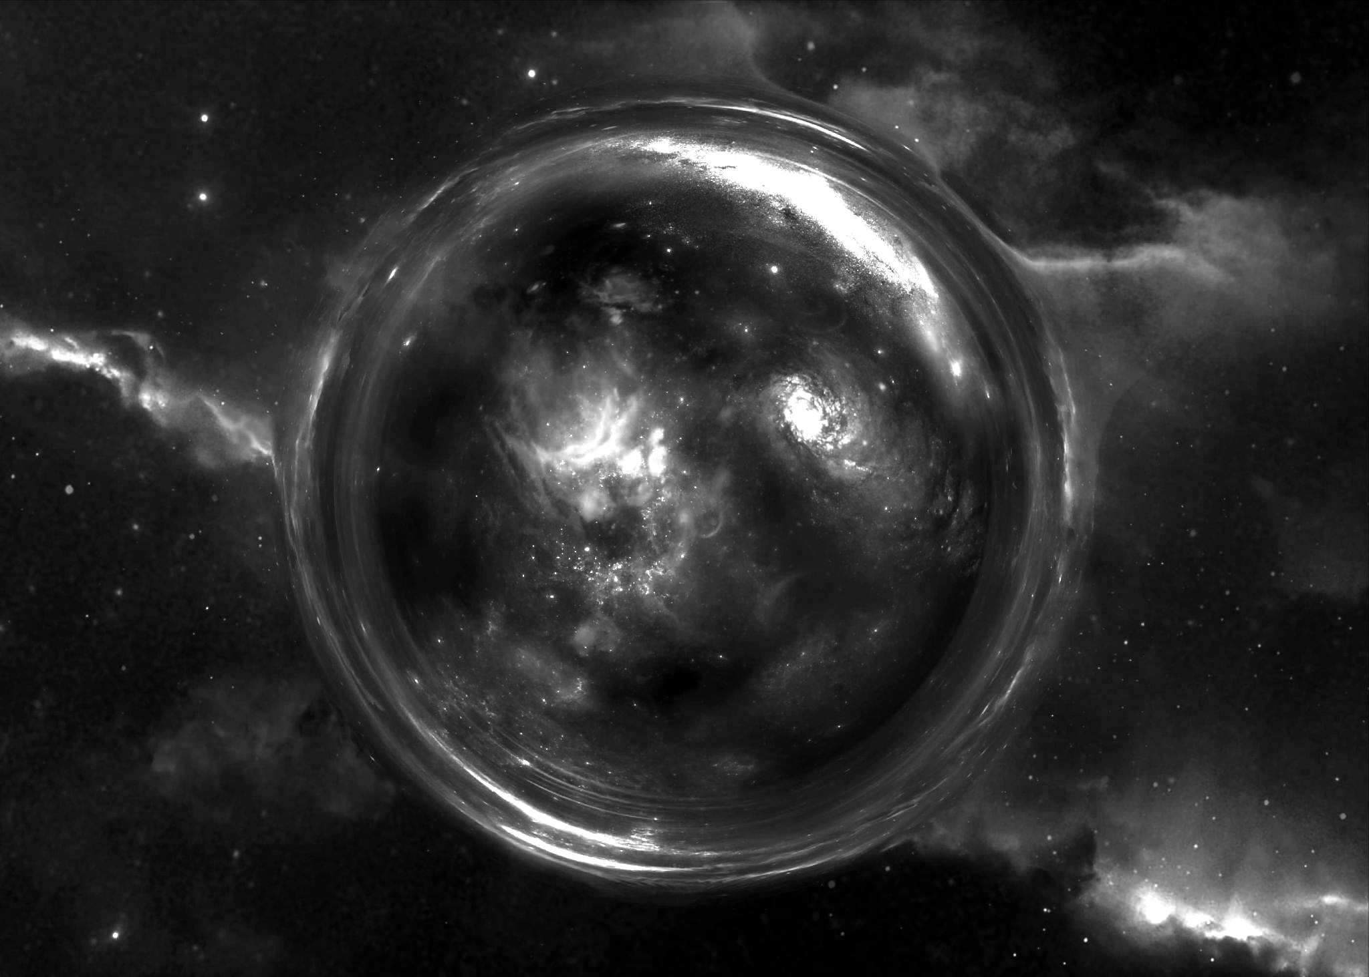
03
PHOTOMETRY

Slide 11
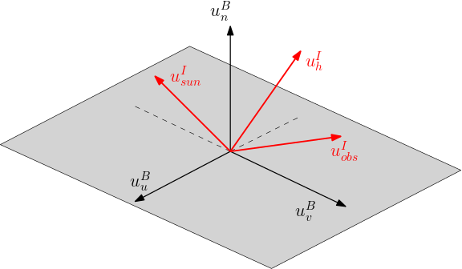
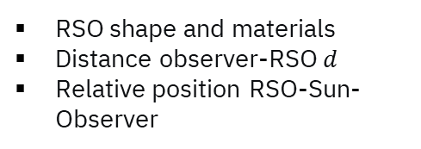
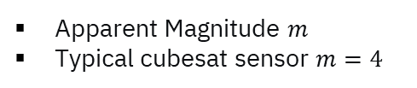
PHOTOMETRY
OBJECTIVE
Obtain simulation-based photometric data
HYPOTHESIS
Phong light reflexion model
RSO has flat faces
RSO is modeledas a satellite
DEPENDANCES
RSO shape and materials
Distance observer-RSO $d$
Relative position RSO-Sun-Observer
RESULT
Apparent Magnitude $m$
Typical cubesat sensor $m=4$
6/16

Slide 12
ANALYSIS & RESULTS
04

Slide 13
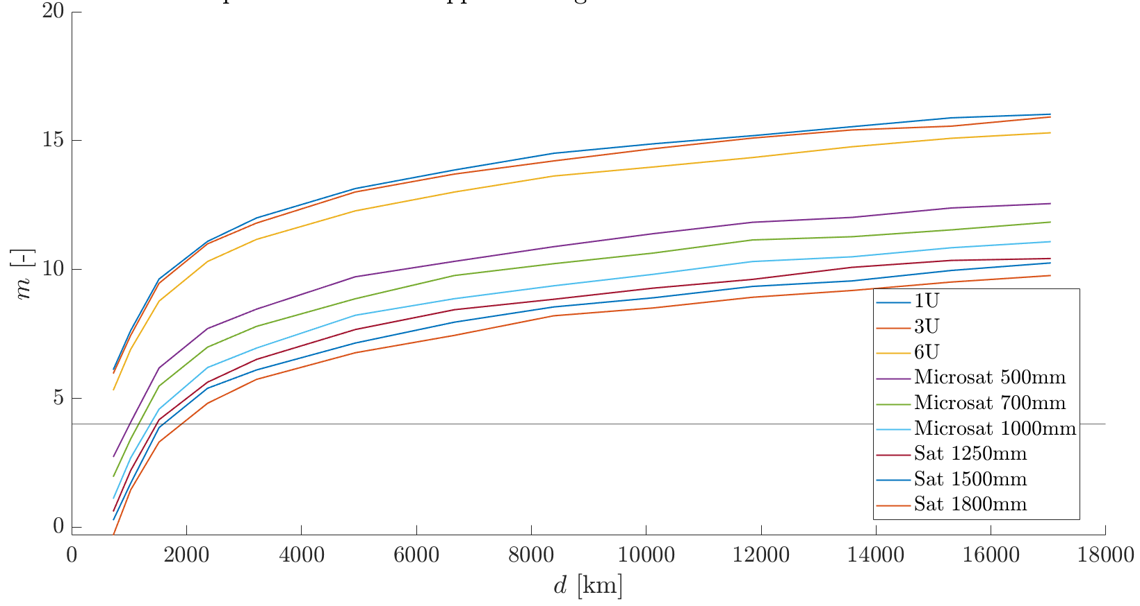
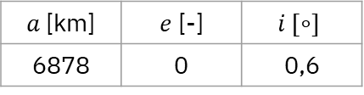
VISIBILITY SPHERE RADIUS
Dependance between apparent magnitude and d
RSO orbit parameters
$a$[km] | $e$ [-] | $$i [∘]$$
6878 | 0 | 0,6
7/16

Slide 14
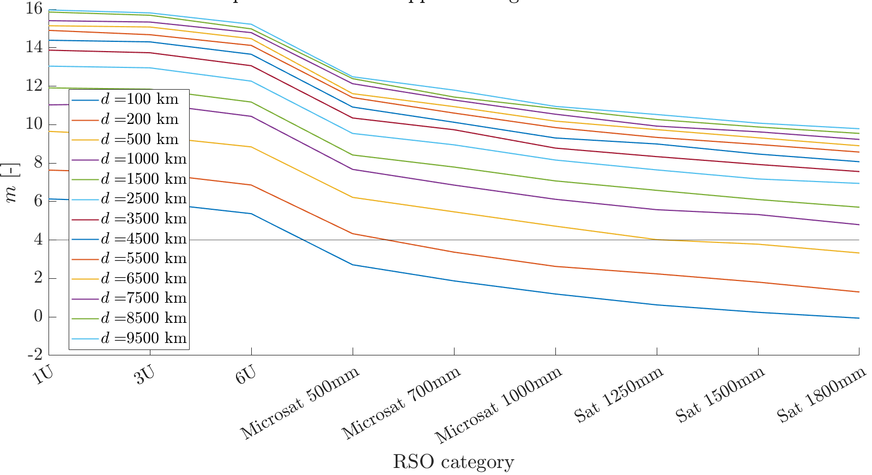
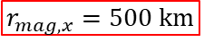
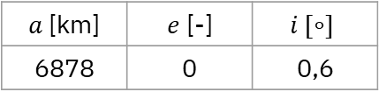
VISIBILITY SPHERE RADIUS
Dependance between apparent magnitude and RSO size
$$r_{mag,x}=500 km$$
RSO orbit parameters
$a$[km] | $e$ [-] | $$i [∘]$$
6878 | 0 | 0,6
8/16

Slide 15
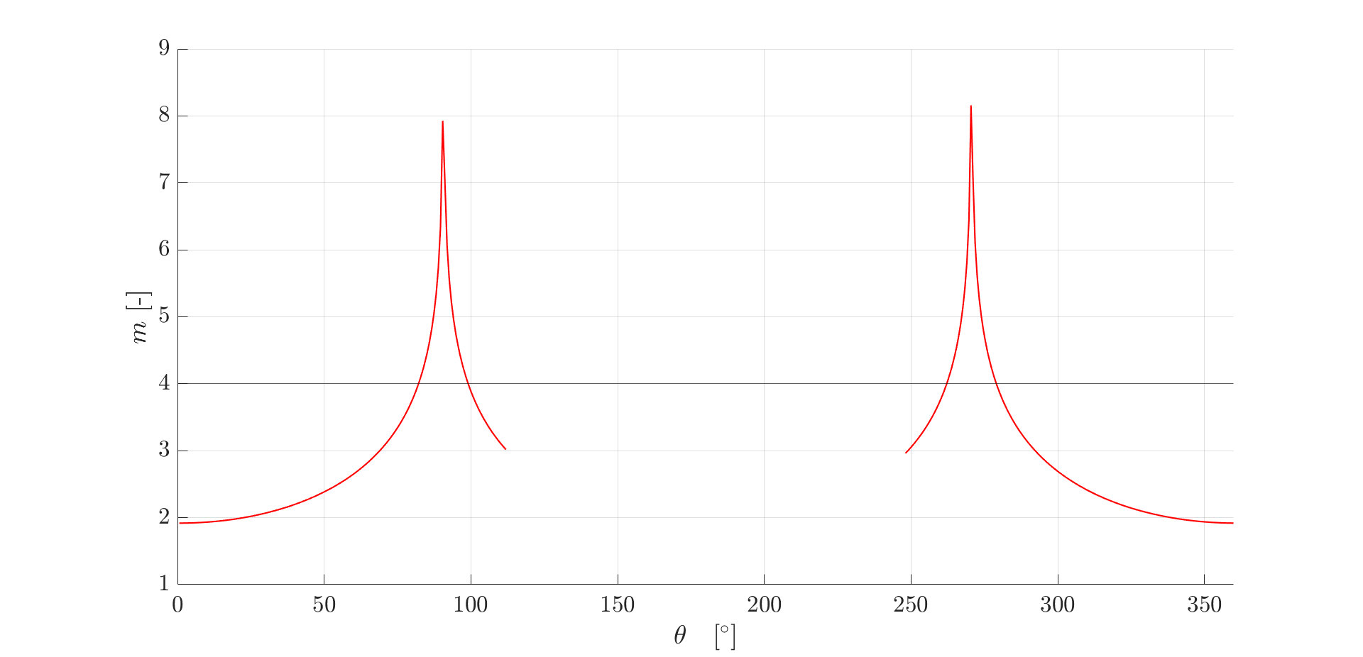
OBSERVATION WINDOWS
Dependance between apparent magnitude m with and the relative positions Sun-Observer.
RSO orbit parameters
 | Start | End
Date | 1 Jan 2023 | 16 June 2023
$θ= \hat{r_{RSO}, r_{Sun}},$projected on the equatorial plane
9/16

Slide 16
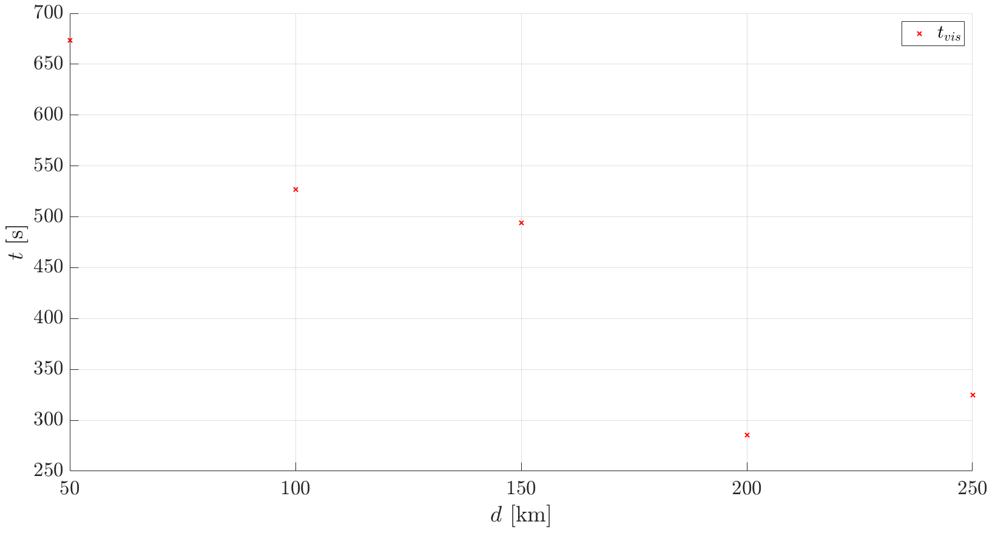
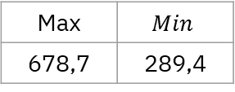
VISIBILITY TIMES
Dependance between visibility time and distance
x
x
x
RSO is a 1.2 m satellite
5 observers
x
Average visibility times [s]
x
Max | $$Min$$
678,7 | 289,4
10/16

Slide 17
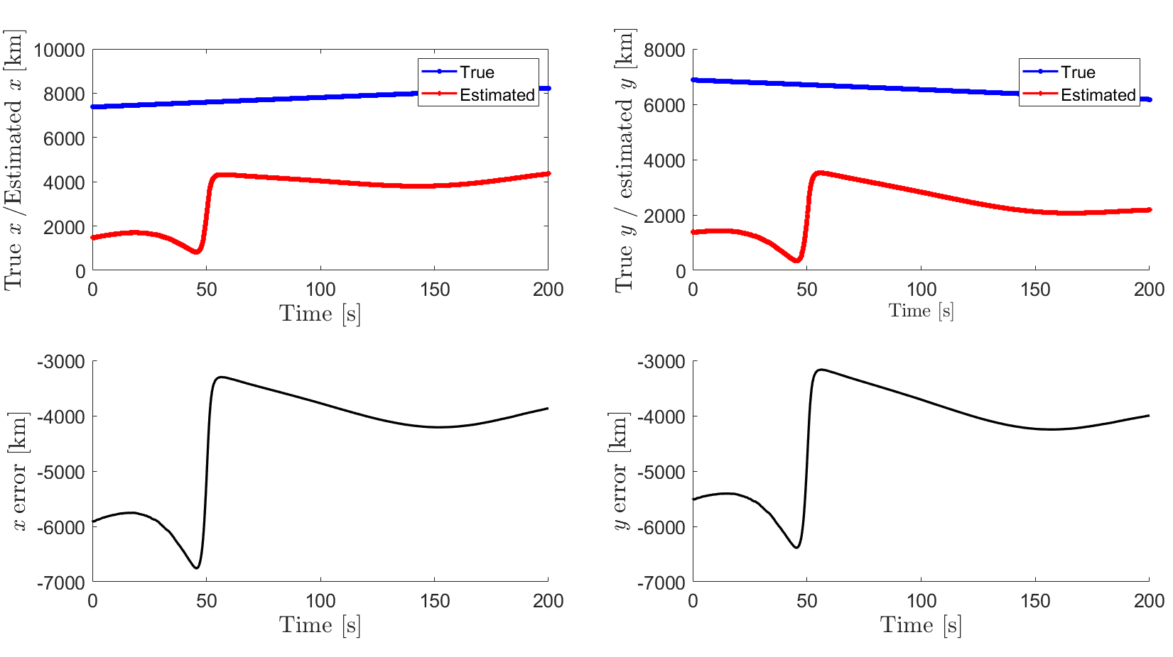
UKF PRECISSION
XY error for d = 50 km and t = 200 s with 1 observer.
11/16

Slide 18
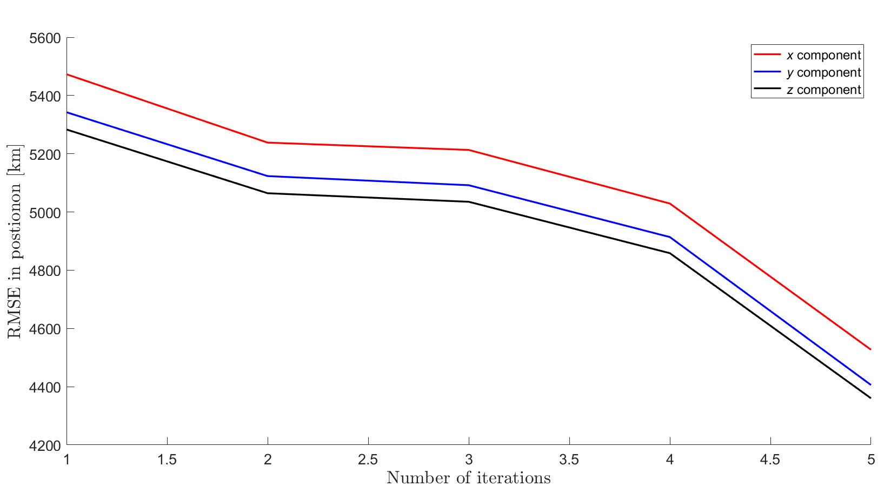
UKF PRECISSION
RMSE error for d = 50 km and t = 200 s with 1 observer.
11/16

Slide 19
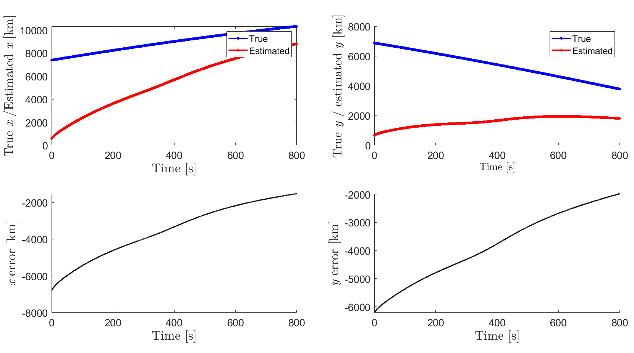
UKF PRECISSION
XY error for d = 50 km and t = 800 s with 1 observer.
12/16

Slide 20
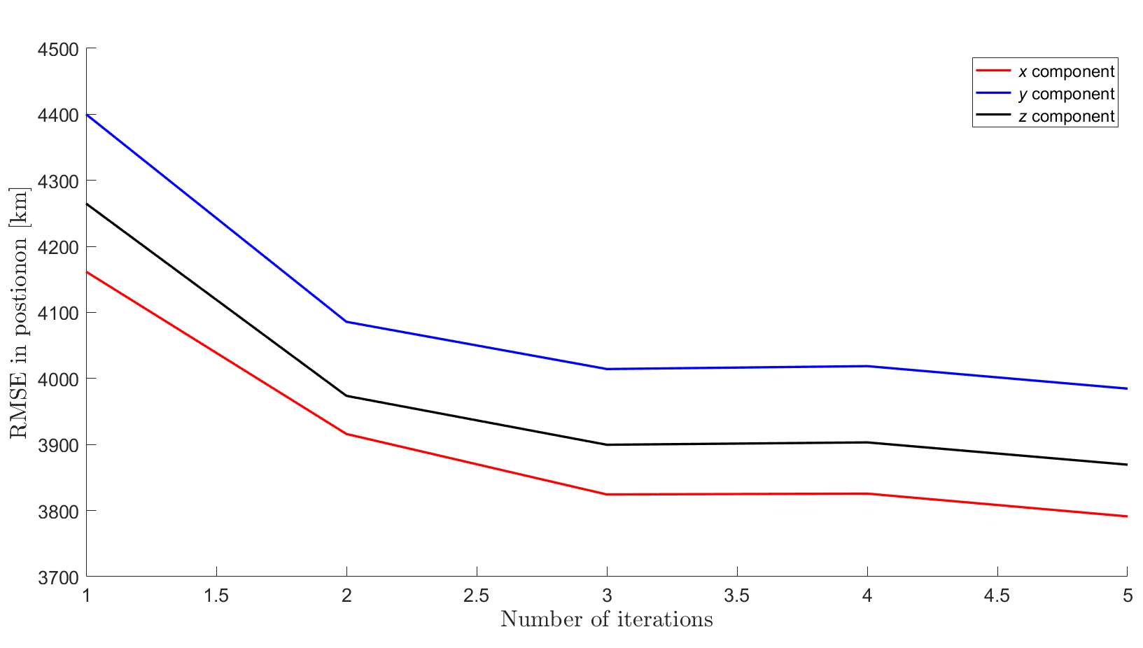
UKF PRECISSION
RMSE error for d = 50 km and t = 800 s with 1 observer.
11/16

Slide 21
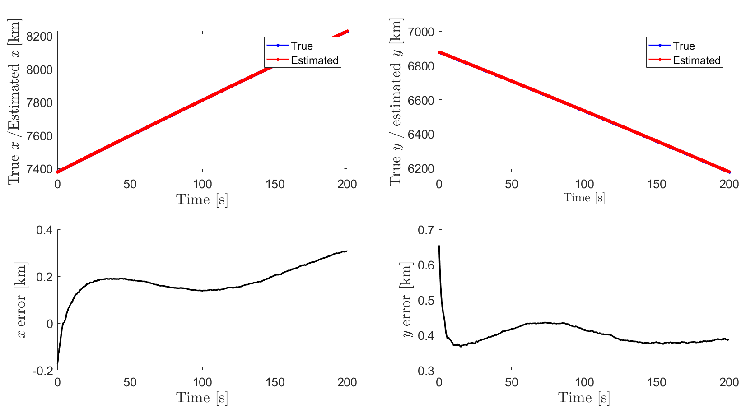
UKF PRECISSION
XY error for d = 50 km and t = 200 s with 2 observers.
13/16

Slide 22
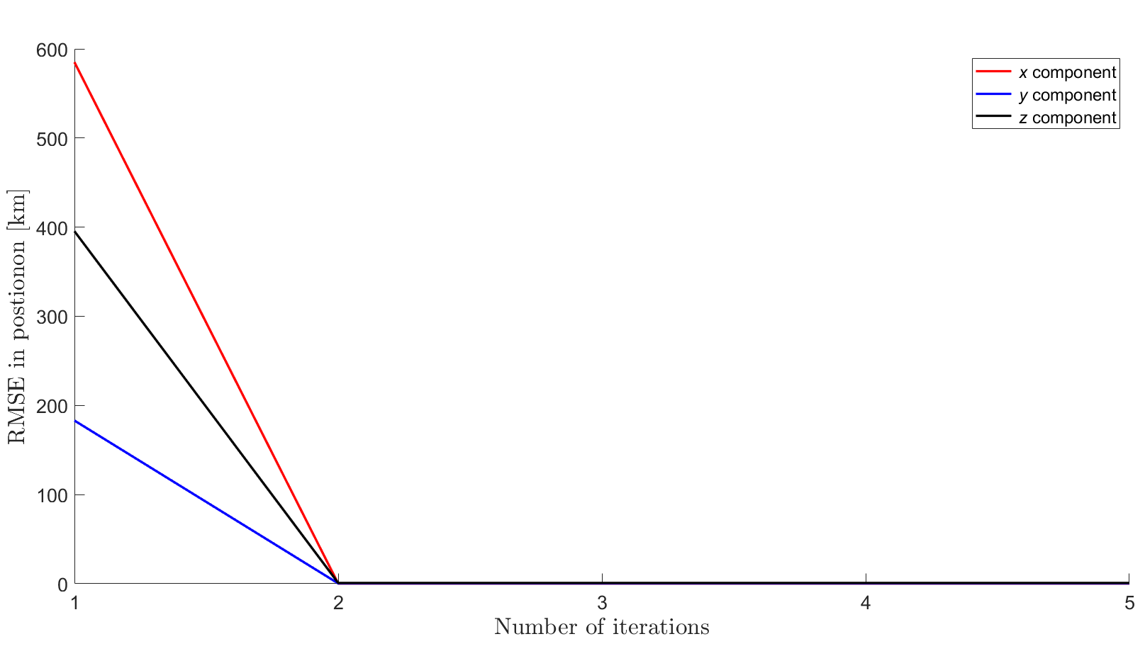
UKF PRECISSION
RMSE error for d = 50 km and t = 200 s with 2 observers.
11/16

Slide 23
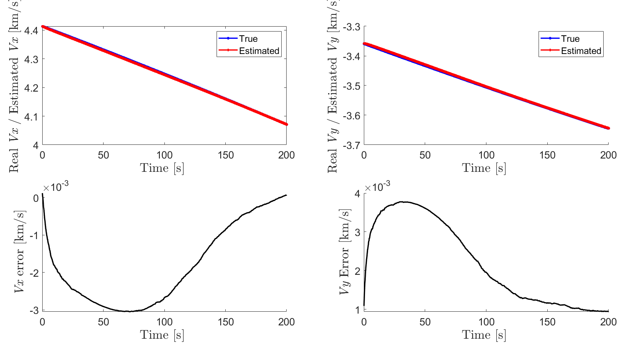
UKF PRECISSION
XY error for d = 50 km and t = 200 s with 5 observers.
14/16

Slide 24
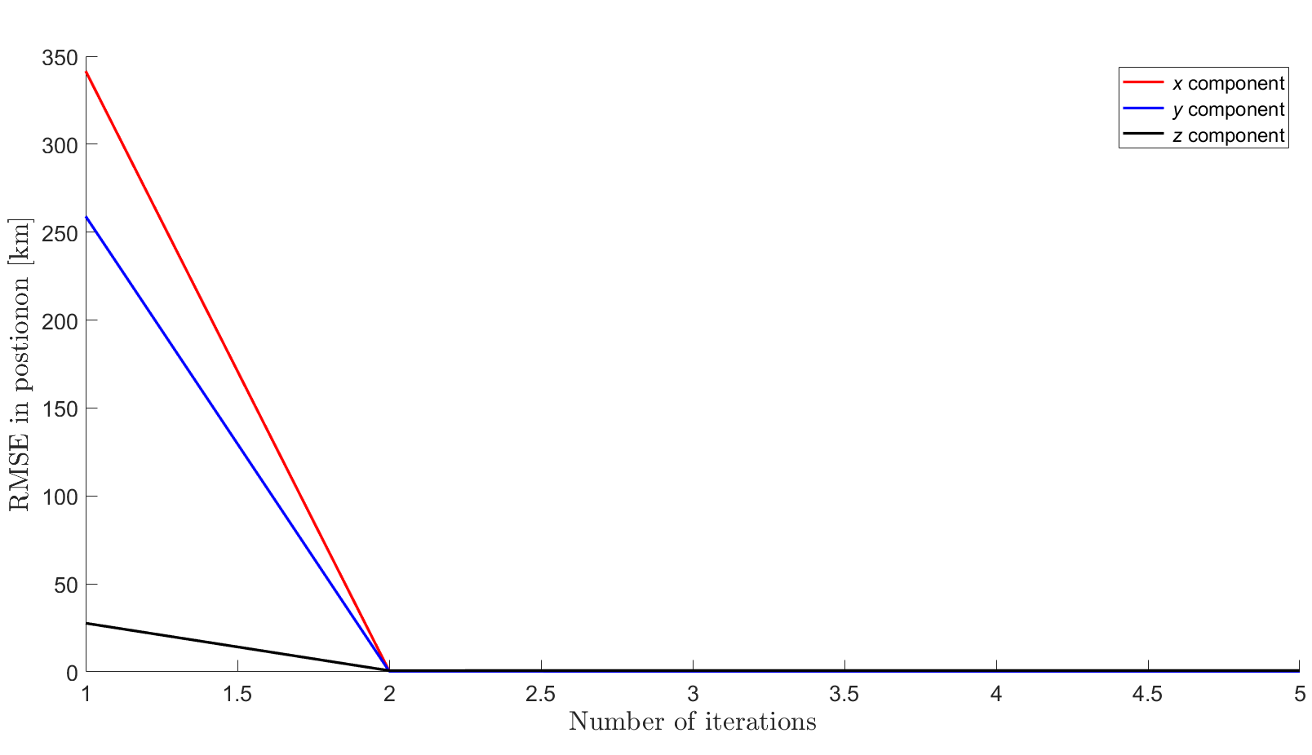
UKF PRECISSION
RMSE error for d = 50 km and t = 200 s with 1 observer.
11/16

Slide 25
05
CONCLUSIONS

Slide 26
CONCLUSIONS
Code refactored for improved structure and modularity
User-friendly script for simulation execution developed
Photometry module calculates apparent magnitude, providing insights for future work
Initial observation constellation prototype developed, requiring further refinement
Sensitivity analysis identifies the number of observers as a critical variable for future improvements
15/16

Slide 27
FUTURE WORK
The implementation of various types of constellations, so that the RSO
is always within the visibility sphere of at least two satellites
The expansion of functionalities within the photometry module to allow for diverse modeling of the RSO, for example, using light curves.
The incorporation of RSO modeling into the estimator. This involves modifying the estimator so that magnitude becomes the input, rather than the position vector.
The execution of extensive analyses to obtain a diverse population, facilitating more nuanced
and quantitative results.
16/16

Slide 28
REFERENCES
Ashikmin, M., and P. Shirley. 2000. “An Anisotropic Phong Light Reflection Model.” Technical Report UUCS-00-014. Salt Lake City, UT: University of Utah.
C. G. Bassa, O. R. Hainaut, and D. Galadí-Enríquez. 2022. “Analytical Simulations of the Effect of Satellite Constellations on Optical and Near-Infrared Observations.” Astronomy & Astrophysics 657 (A75): 19. https://doi.org/10.1051/0004-6361/202142101.
Centinello, F. J. 2008. “Six Degree of Freedom Estimation with Light Curve Data.” Technical Report. Kihei, HI: Air Force Research Laboratory.
Chessab Mahdi, Mohammed. 2016. “Study the Space Debris Impact in the Early Stages of the Nano-Satellite Design.” Artificial Satellites. https://doi.org/10.1515/arsa-2016-0014.
Clormann, & Klimburg-Witjes, M. 2022. “Troubled Orbits and Earthly Concerns: Space Debris as a Boundary Infrastructure.” Science, Technology, & Human Values. https://doi.org/10.1177/01622439211023554.
G.Marchand, Belinda, and J.Kobel Christopher. 2008. “A Comparison of Satellite Constellations for Continuous Global Coverage.” Edited by The Aerospace Corporation. Galveston.
Jah, M., and R. Madler. 2007. “Satellite Characterization: Angles and Light Curve Data Fusion for Spacecraft State and Parameter Estimation.” In Proceedings of the Advanced Maui Optical and Space Surveillance Technologies Conference. Vol. 49. Wailea, Maui, HI.
Julier, S. J., and J. K. Uhlmann. 2004. “Unscented Filtering and Nonlinear Estimation.” Proceedings of the IEEE 92 (3): 401–22. https://doi.org/10.1109/JPROC.2003.823141.
Kandepu, R., L. Imsland, and B. A. Foss. 2008. “Constrained State Estimation Using the Unscented Kalman Filter.” In 2008 16th Mediterranean Conference on Control and Automation, 1453–58. IEEE.
Lang, Thomas J., and William S. Adams. 1998. “A Comparison of Satellite Constellations for Continuous Global Coverage.” Edited by Jozef C. van der Ha. Dordrecht: Springer Netherlands.
LaViola, J. J. 2003. “A Comparison of Unscented and Extended Kalman Filtering for Estimating Quaternion Motion.” In Proceedings of the 2003 American Control Conference, 2003., 3:2435–2440 vol.3. https://doi.org/10.1109/ACC.2003.1243440.
Linares, Richard, Moriba K. Jah, John L. Crassidis, Fred A. Leve, and Tom Kelecy. 2014. “Astrometric and Photometric Data Fusion for Inactive Space Object Mass and Area Estimation.” Acta Astronautica 99: 1–15. https://doi.org/https://doi.org/10.1016/j.actaastro.2013.10.018.
Schildknecht, T. 2007. “Optical Surveys for Space Debris.” Astron. Astrophys. Rev. 14 (1): 41–111.

Slide 29
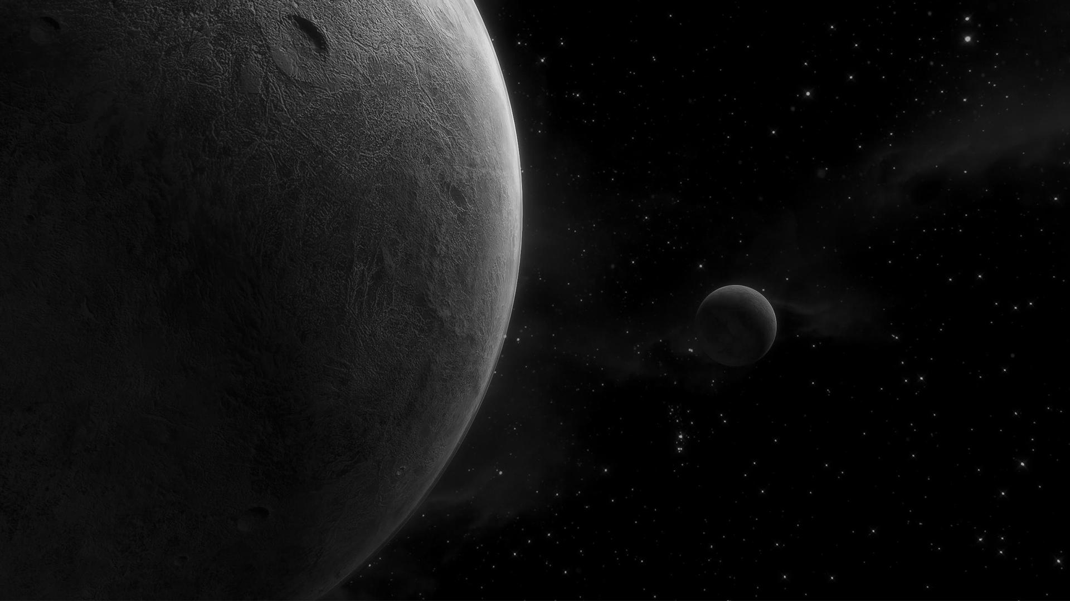
QUESTIONS?

Slide 30
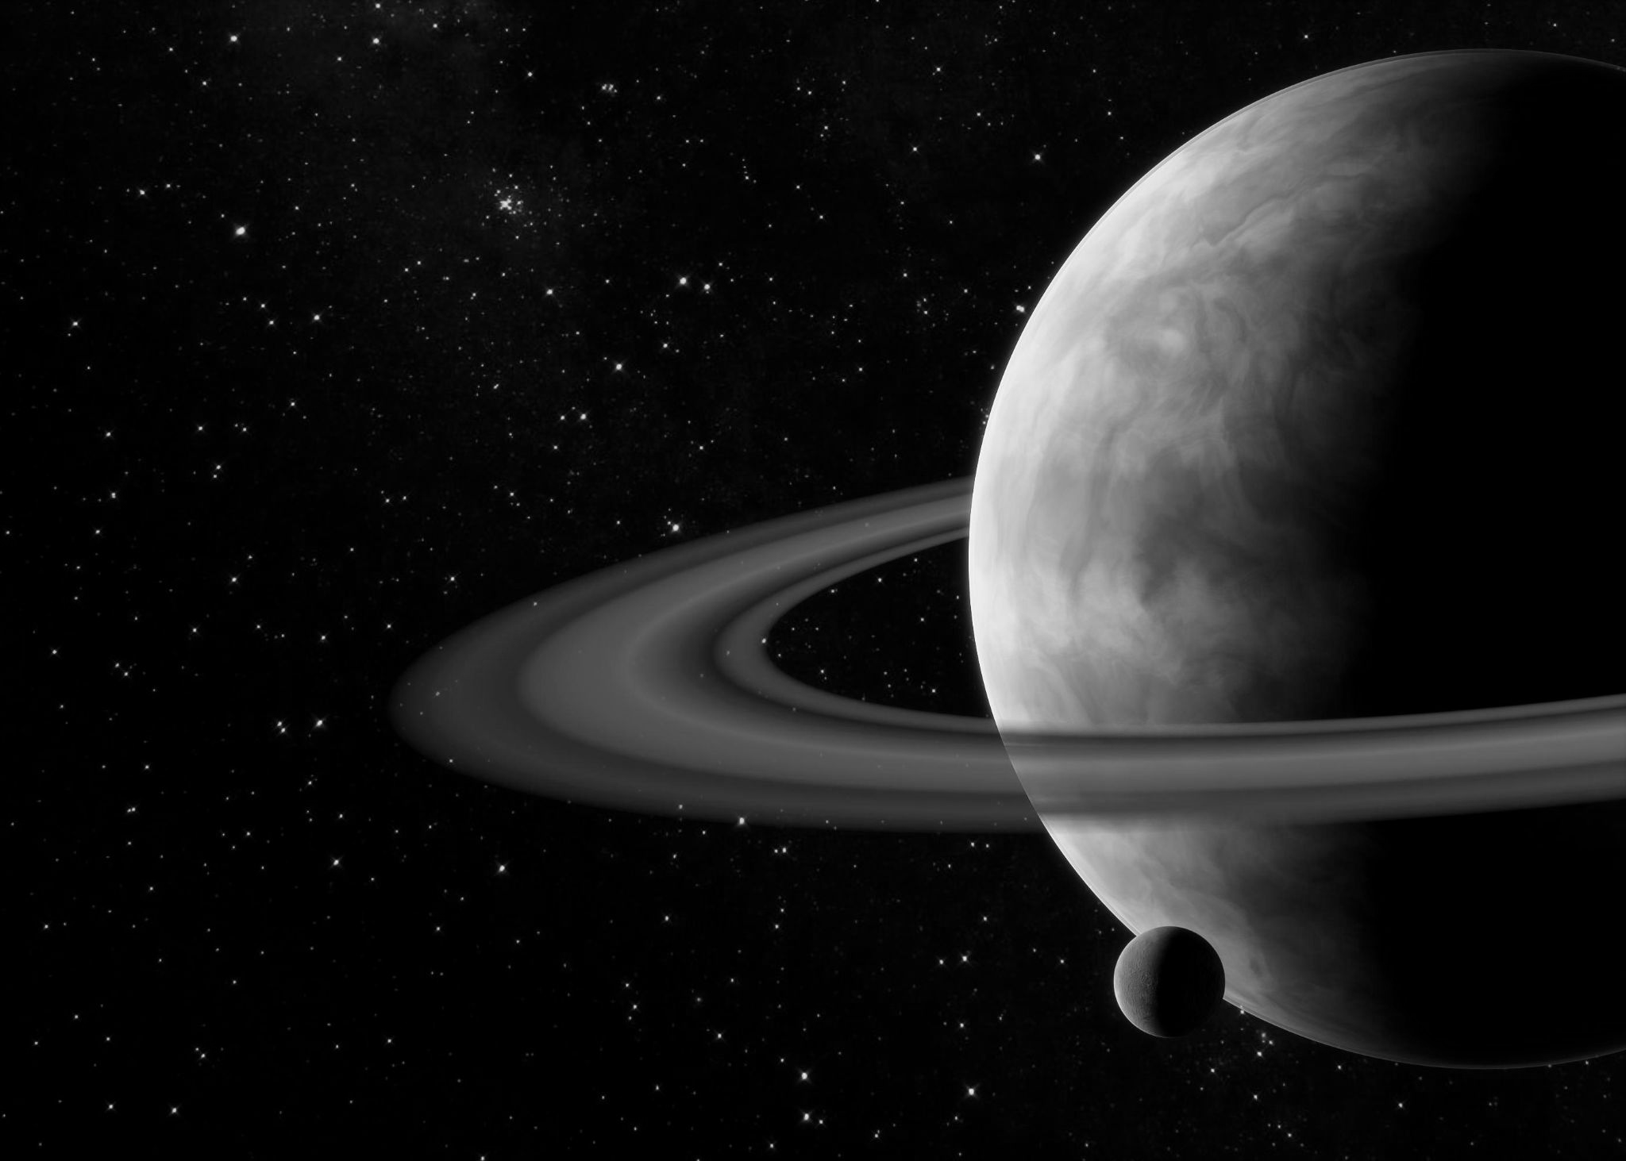
APPENDIX

Slide 31
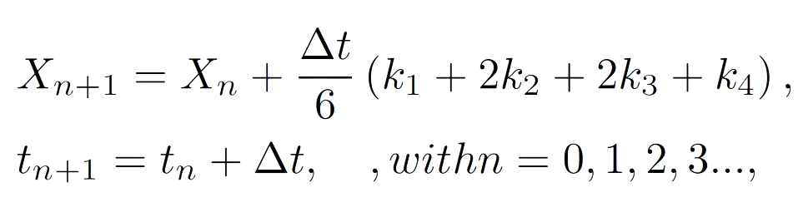
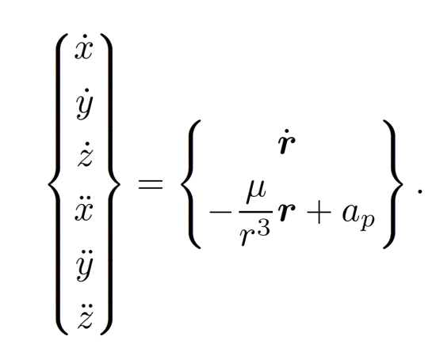
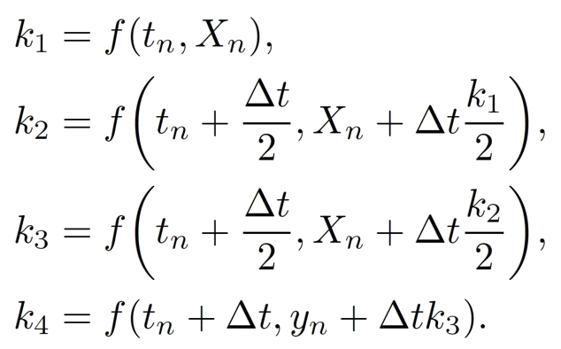
A1. SIMULATOR
Newton Equation propagated with RK4
15/16

Slide 32
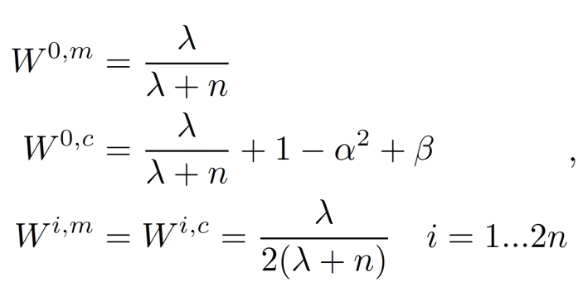
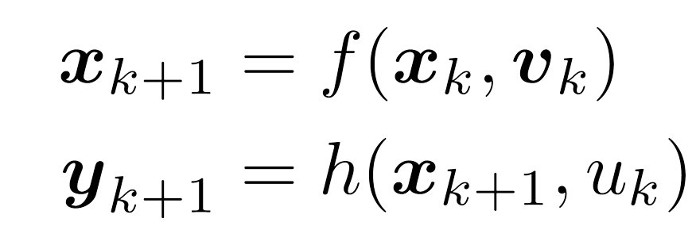
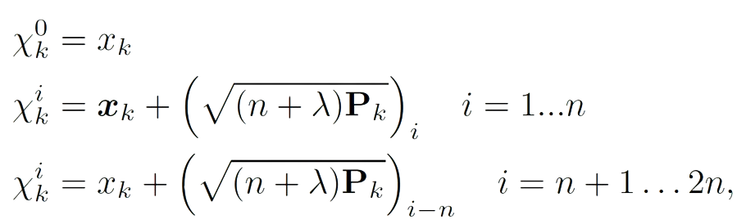
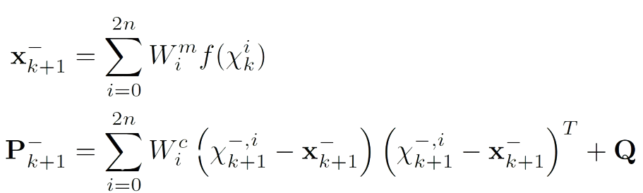
A2. UKF FORMULATION
Consider this non-linear system
And the weights associated to these points
Assuming a known (or accurately estimated) covariance matrix of the state variables (Pk) the sigma points are:
Then, the predicted state and covariance matrix are:
15/16

Slide 33
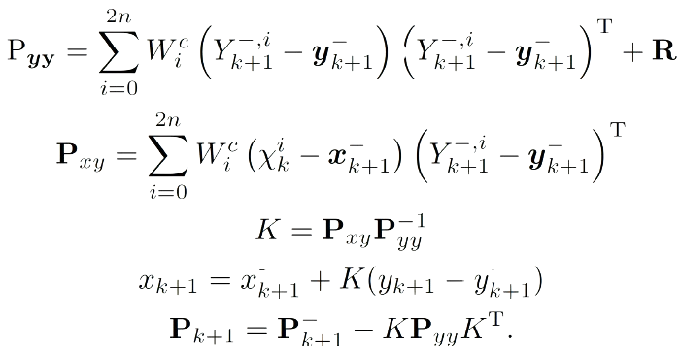
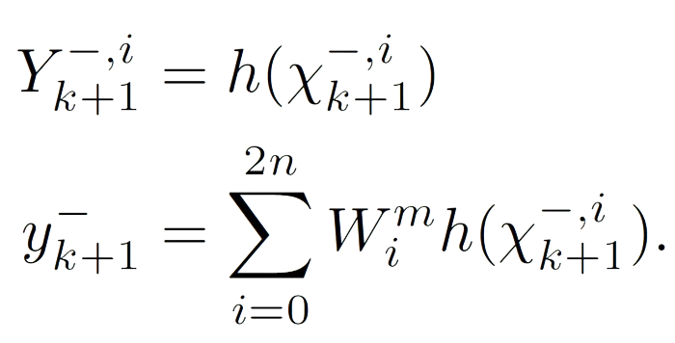
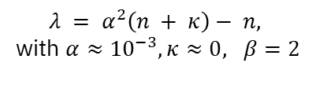
A2. UKF FORMULATION
This first prediction step keeps estimating the
estate variables until there is a new experimental (or simulated) measurement available, starting
the correction step. When this happens, the expected state is calculated as follows
Having the expected measurement, the corrected state can be calculated as:
$λ = α^{2}\left(n + κ\right)− n,$
with $α≈{10}^{−3},κ≈0, β=2$
15/16

Slide 34
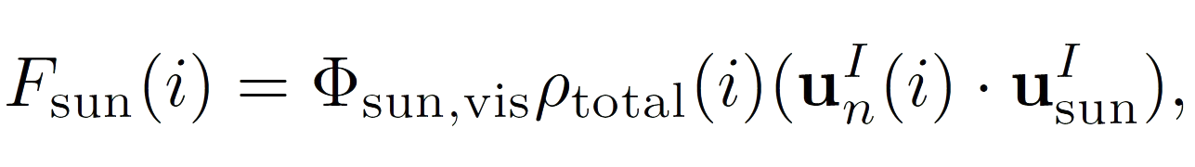
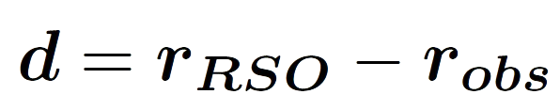
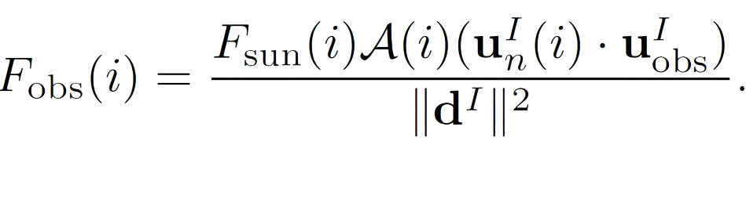
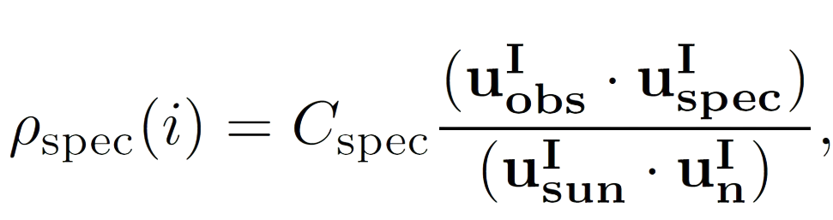
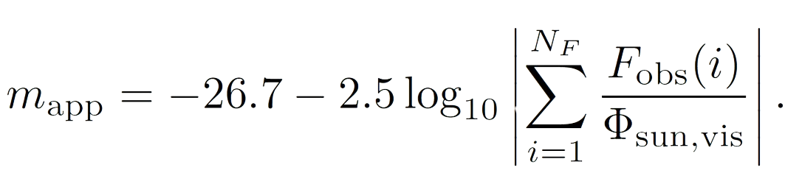
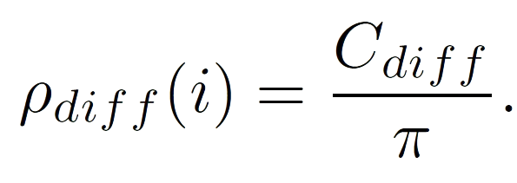
A3. M.APP. CALCULATION
Vector from the observer to the RSO
The fraction of (visible) light reaching the RSO is:
Decompose the BDRF (Phong reflexión model
Only a fraction of the light reflected by the RSO is visible to the observer:
where:
Finally, the apparent magnitude is given by:
15/16

Slide 35
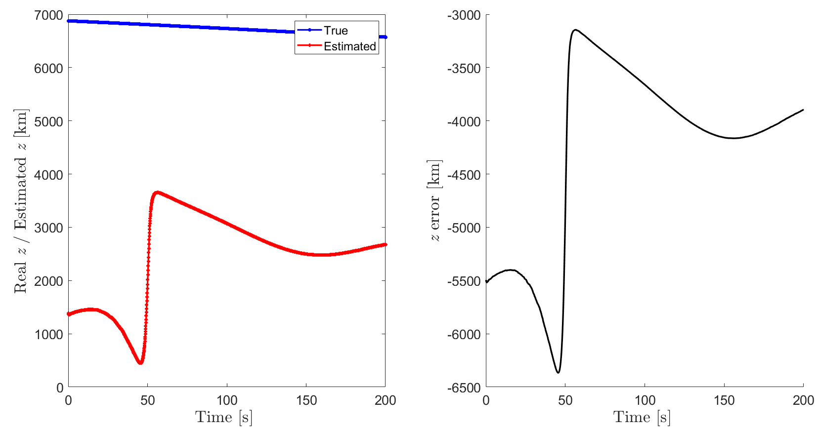
A4. UKF ANALYSIS
Z error for d = 50 km and t = 200 s with 1 observer.

Slide 36
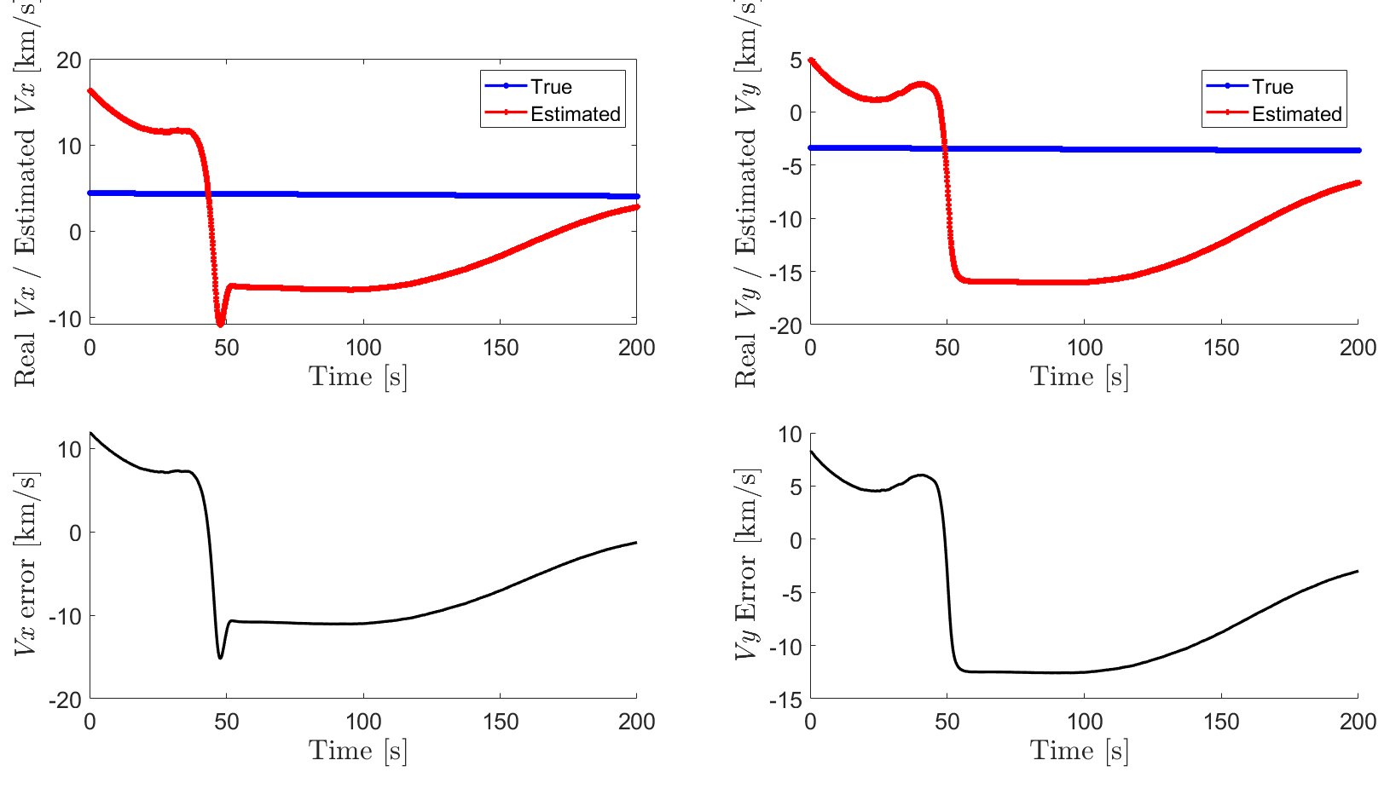
A4. UKF ANALYSIS
Velocity XY error for d = 50 km and t = 200 s with 1 observer.

Slide 37
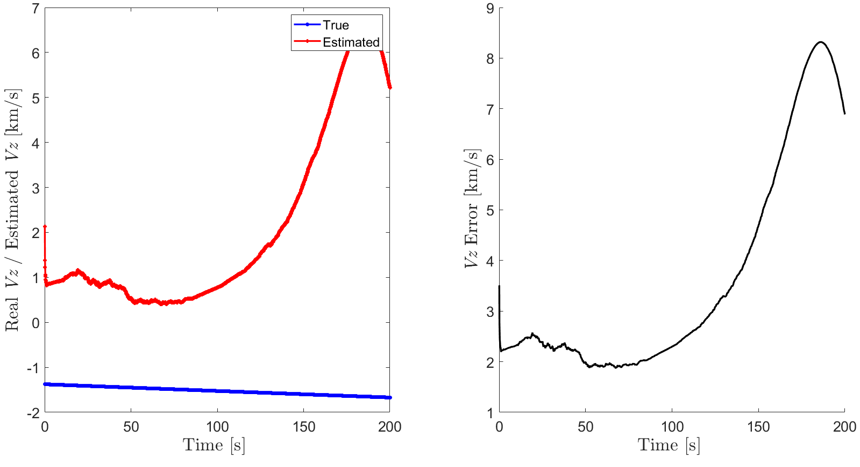
A4. UKF ANALYSIS
Velocity Z error for d = 50 km and t = 200 s with 1 observer.

Slide 38
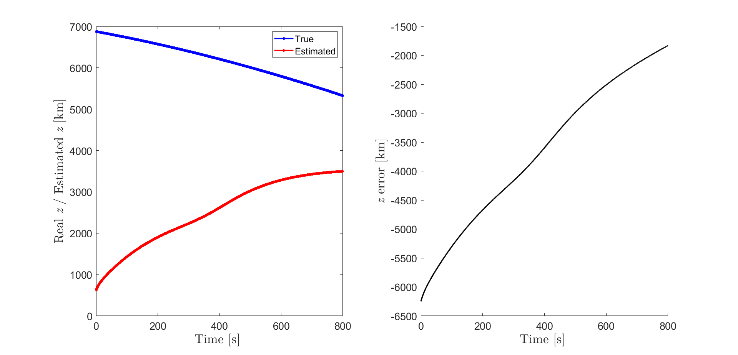
UKF PRECISSION
Z error for d = 50 km and t = 800 s with 1 observer.

Slide 39
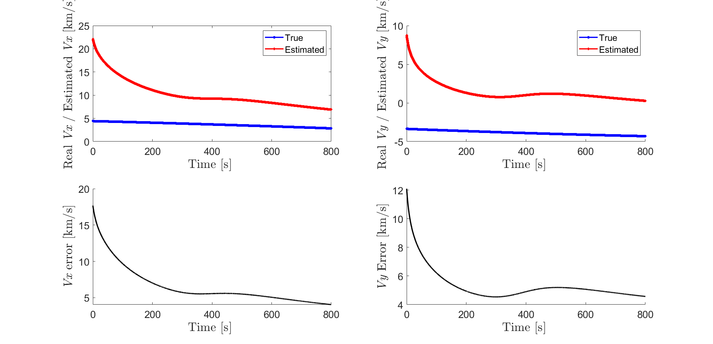
A4. UKF ANALYSIS
Velocity XY error for d = 50 km and t = 800 s with 1 observer.

Slide 40
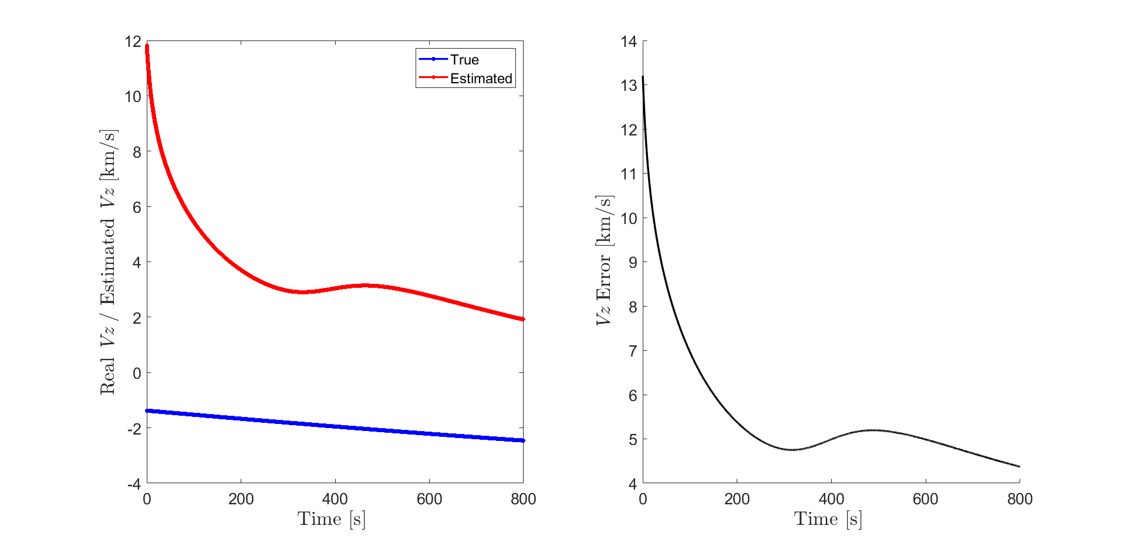
A4. UKF ANALYSIS
Velocity Z error for d = 50 km and t = 800 s with 1 observer.

Slide 41
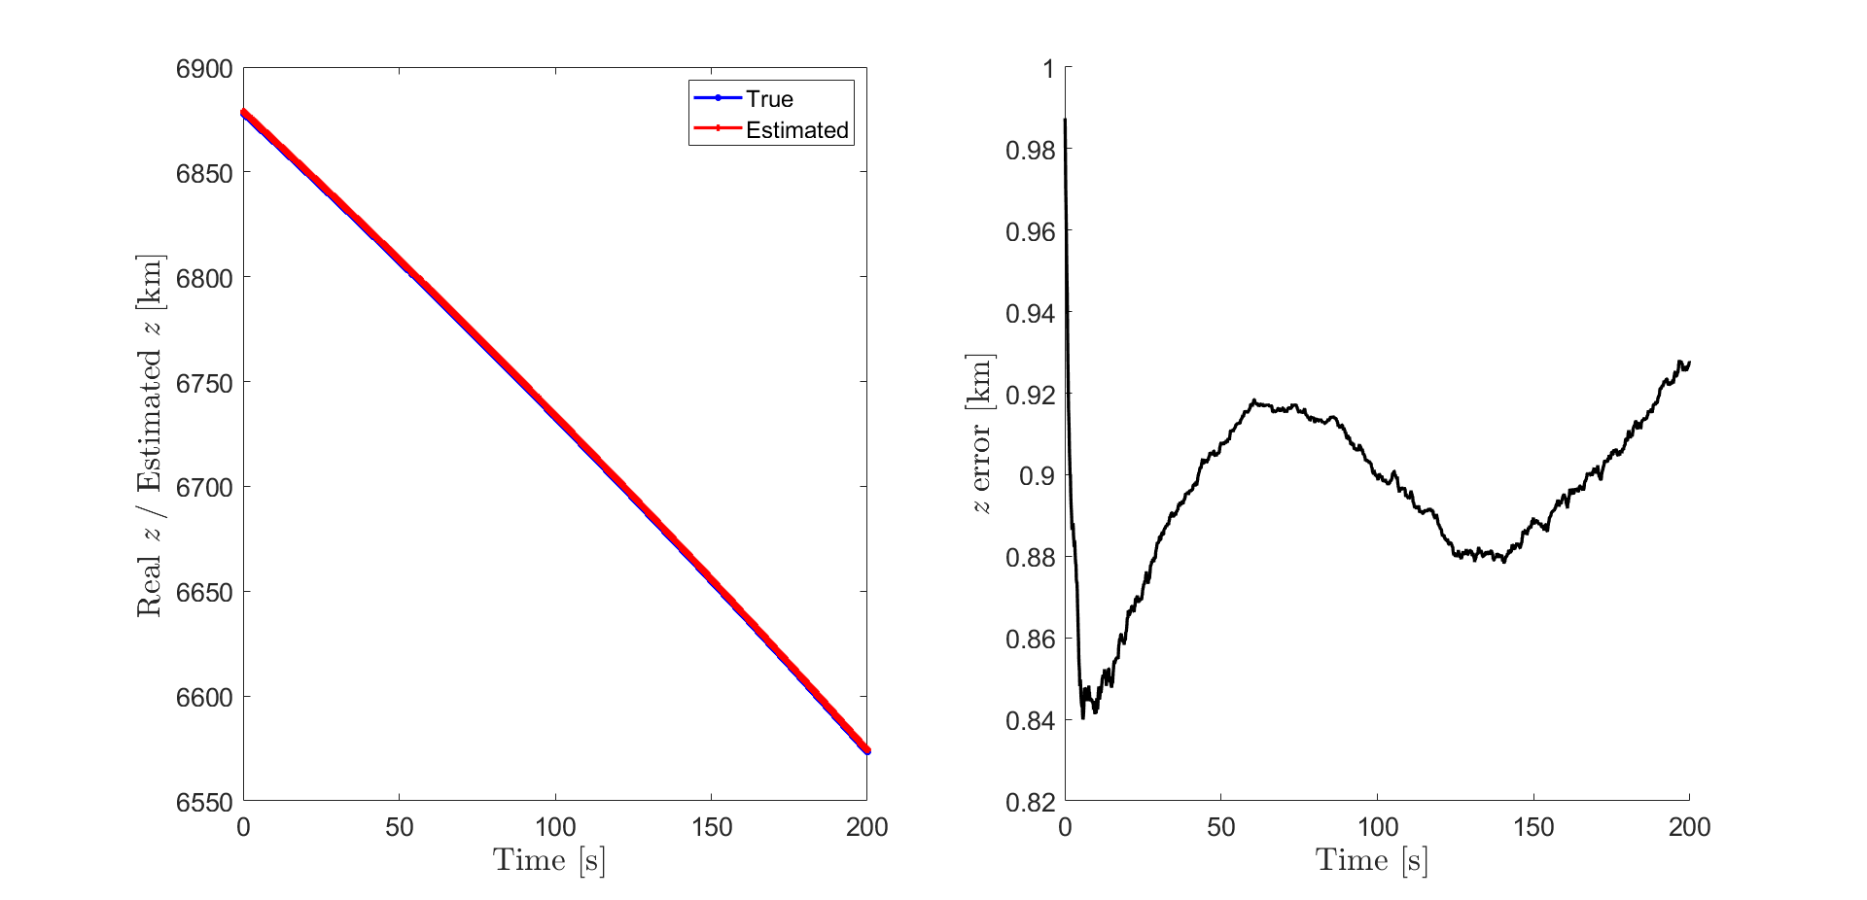
A4. UKF ANALYSIS
Z error for d = 50 km and t = 200 s with 2 observer.

Slide 42

A4. UKF ANALYSIS
Velocity XY error for d = 50 km and t = 200 s with 2 observer.

Slide 43

A4. UKF ANALYSIS
Velocity Z error for d = 50 km and t = 200 s with 2 observer.

